Slide 1
17-612 Fall 2023
Business & Marketing Strategy
Class 3
Jim Berardone
Associate Professor of the Practice of Product Management

Slide 2
Today’s Class
Know what strategy is and why it’s important
Know the elements of strategy
Company strategy
Product line strategy
Objective:
To recognize strategy and its elements so you can put it to use

Slide 3
The first 3 classes are about Context.
What is the current state of the business?
Where are they going? How will they get there? Why will they win?
1. Company context
Mission
Financial situation
Strategy
2. Product line context
Current products
Strategy
Knowing the context makes it possible to propose ideas that can supported.

Slide 4
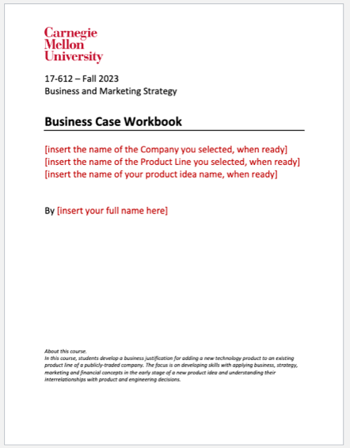
Product Assignment No. 2 The Strategy Context and New Product Idea
Due Tue Sep 12 at start of class
1. Business Strategy (of your company)
2. Product Line Strategy
3. Product Idea
4. Strategy Alignment discussion
Business Case Workbook.docx

Slide 5
The cadence of work for the next 7 days
Tue | Wed | Thu | Fri | Sat | Sun | Mon
Class 1. Bus. Strategy 2. Product Line Strategy | Post-Class Activity 1. Watch Video 2. Read HBP article | Class 1. Idea Generation 2. Description Peer Learning Activity Share your company & product line | Post-Class Activity 1. Read Idea Desc. slides 2. Read HBP articles (2) | Peer Learning Activity Give product ideas to each student in your peer group. | Work on Product Assignment No. 2 Business Strategy Product Line Strategy Product Idea Strategic Alignment
Tue | Wed | Thu | Fri | Sat | Sun | Mon
Product Assignment no. 2 is due Class

Slide 6
Strategy

Slide 7
There are many terms used in “strategy”
Goals
Objectives
Vision
Mission
Business Strategy
Business Unit Strategy
Competitive Strategy
Market Strategy
Product Strategy
Platform Strategy
Technology Strategy
Competitive Advantage
Market Entry Strategy
Marketing Strategy
Sales Strategy
Pricing Strategy
Distribution Strategy
Regulatory Strategy
Plans
Tactics
Initiatives
Competencies
Capabilities
Resources

Slide 8
There are at least 10 schools of thought on Strategy According to research by Prof. Henry Mintzberg, McGill University, Canada
Design
Planning
Positioning
Configuration
Cognitive
Cultural
Entrepreneurial
Environmental
Learning
Power

Slide 9
Strategy is…
The destination(s) you choose and how you will achieve them.
Current State
“As Is”
Now
Future State
“To Be”
Long-term
Strategy helps to set priorities and make decisions – what we will do and what we won’t do.
A strategy considers resources are limited and conditions are uncertain.

Slide 10
A “typical” strategy creation process
1. Understand the external environment
– trends, opportunities, changes
– competition
2. Understand the internal environment
– business situation, leadership, goals, past performance, resources and capabilities
3. Analyze the possibilities
- Strengths, Weaknesses, Opportunities and Threats (SWOT analysis)
4. Set goals (targets) and measurements
5. Decide on how to achieve the goals.
There are many techniques used to create strategy:
SWOT Analysis
Porter’s Five Forces Industry Analysis
Value Chain Analysis
Blue Ocean Canvas
Business Model Analysis
Scenario Analysis
Market Analysis
Market Positioning Analysis
Benchmarking
…and so many more.

Slide 11
The best results occur when there is strategic alignment… …when everyone is committed to the same long-term destination
Mission
Objectives & Goals
Strategies
Product Line initiatives
Vision
Product initiatives
Top-down strategy
Bottom-up execution
Notes:
A company’s goals and strategies cascade downward.

Slide 12
Every level has a vision, goals and strategies.
Microsoft
$10 Billion
Productivity
$6 Billion
Personal Computing
$2 Billion
Intelligent Cloud
$2 Billion
Office
$4 Billion
Teams
Dynamics
LinkedIn
Word
$2 Billion
Excel
$1 Billion
Outlook
$0.75 Billion
PowerPoint
$0.25 Billion
These numbers are made up, but they add up to the numbers above them.
Product teams can use the higher-level vision, goals and strategies to set priorities and make decisions.

Slide 13
For your project in this course:
You will USE the
business strategy (corporate level)
and product line strategy
to make decisions.
You need to recognize these strategies. You may need to infer their strategy from their actions/decisions.

Slide 14
Strategy elements

Slide 15
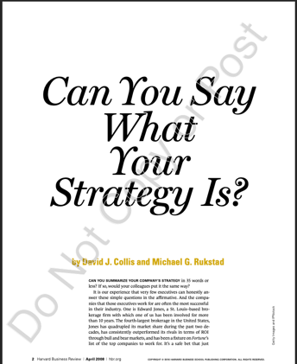
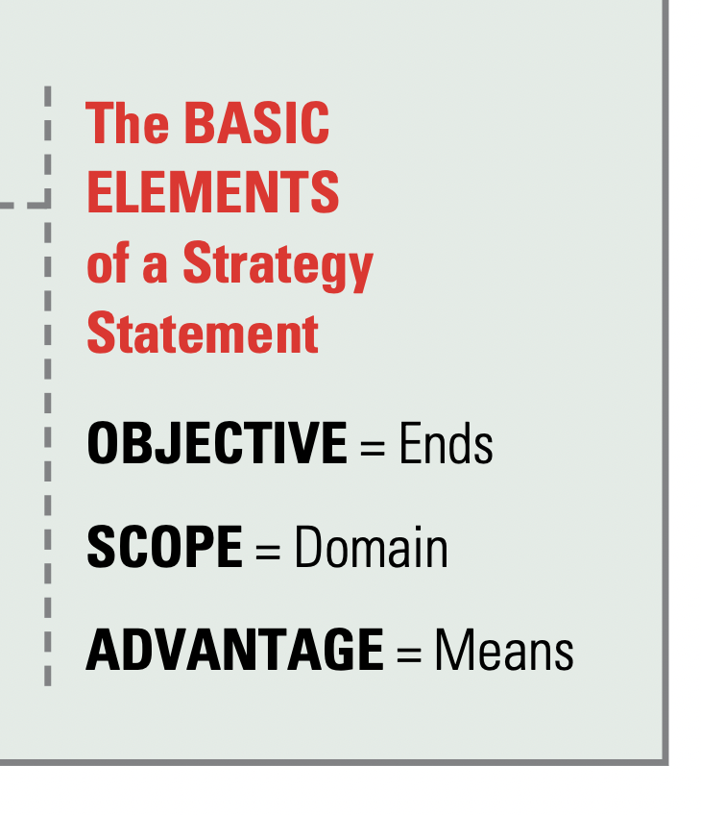
Post Class Activity This article in your coursepack identifies 3 elements of a clear strategy
My 4th element:
HOW = approach

Slide 16

The 1st element of strategy
Objectives = Ends
Where are we going?
The answers drive the product activities and decisions (and others) over the next 3-5 years.
Also known as: Objectives, Goals, Vision
My 4th element:
HOW = approach

Slide 17
Common Company Objectives These lead to an increase in the value of the company
Revenue objective
Sometimes, this is stated by the company.
Sometimes, you can interpret from the rate of revenue growth of the company
Often companies want revenue to grow as fast as their industry is growing.
Profitability objective
Gross Profit Margin and/or Net Profit Margin
Usually, companies want to be MORE profitable than the average company in their industry
Market share objective
The percentage (%) of sales (revenue or units) in the industry that the company generated.
Often stated as the targeted position in the market (“to be the market leader”)
Or a targeted percentage of the market
Customer Preference
Loyalty: Percentage of customers in an industry who prefer your brand (company, product)
Perception: A certain image in the minds of its targeted customers
Notes:
Example:
We want to be the market leader in smartphones. (market share goal)
We want to be the low-cost producer of smartphones. (profit goal)

Slide 18
Different objectives lead to very different strategies
Objective: Increase revenues at 10% per year
Penetrate existing market with improved products, services, pricing.
Strengthen the product – design, functionality, delivery.
Objective: Increase revenues at 50% per year
Invest in scale – sales, marketing, product, support, service.
Expand sales force, sales offices, distribution channels (places to sell your product)
Expand marketing programs

Slide 19
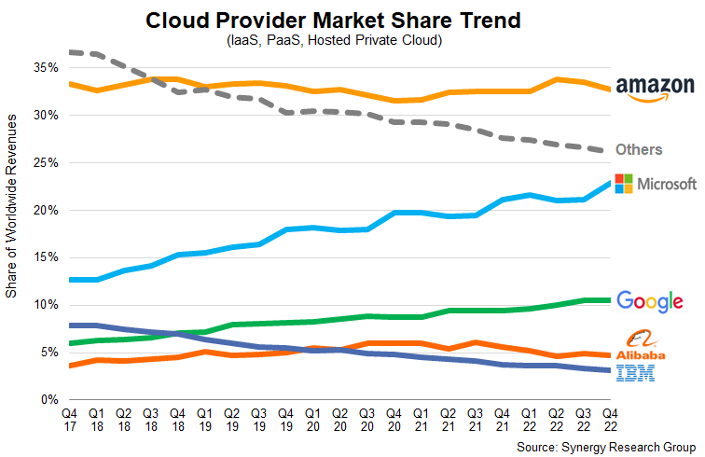
Example: “Objectives”
Is it realistic to achieve in 5 years?
What happens if they don’t?
Google Cloud
become the leading cloud computing platform for businesses of all sizes.
Global market size in 2022
Estimated: 484B (USD)
Source: Grandview Research

Slide 20
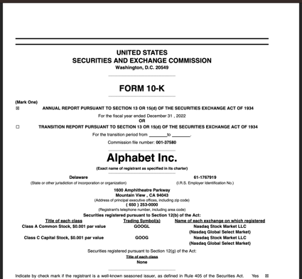
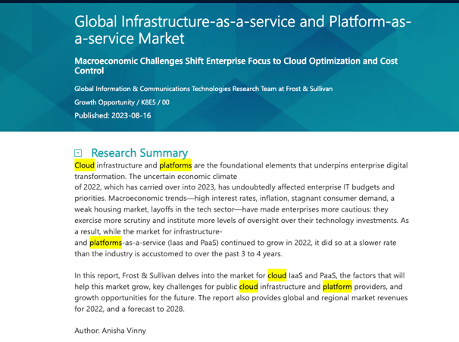
Course Library page
“Company Financials” tab
→10-K (annual report)
“Markets/Industry” tab
→Gartner or Frost-Sullivan research reports

Slide 21
The 2nd element of strategy
Scope = domain
Where do we choose to be active? (where will we NOT be active)?
i.e., markets, users, platforms.
This sets the boundaries for our strategies and plans.
The Scope typically answers one or more of these questions:
Which markets will we serve? (Geography, industries)
Which users / customers will we serve?
Where will customers get our product?
Which platform(s) will we operate?
My 4th element:
HOW = approach

Slide 22
Example: “Scope” for Google Cloud
Targeted for businesses of all sizes
Startups
Small Medium-sized Businesses (SMB)
Enterprises
Aimed at multiple key markets/sectors:
Manufacturing
Education
Media and Entertainment
Retail
Finance
Public Sector
Healthcare
Key Users
Developers, Engineers
System Administrators
IT Managers
Data Scientists and Analysts

Slide 23
The 3rd element of strategy
Advantage
Why will we win?
The answers are:
why customers will choose your product(s).
a.k.a. “competitive advantage”
what the company does better than others.
a.k.a. “core competency”
Example: Zoom
Ease of use, and Higher quality video/audio.
Highly skilled with video communications performance
My 4th element:
HOW = approach

Slide 24
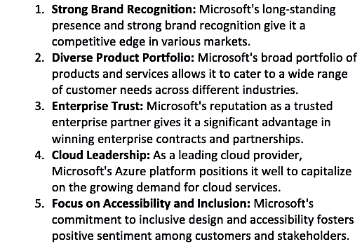
Example “Advantage”: Microsoft

Slide 25
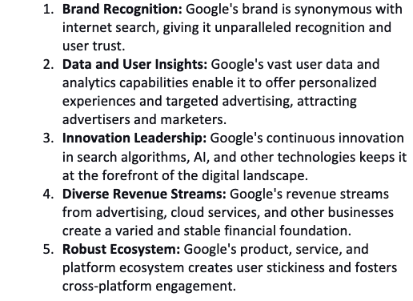
Example ”Advantage”: Google

Slide 26
The 4th element of strategy
How
How will we get there? (How will achieve the Objectives)?
The answer is the company’s (or product line’s) own, unique approach.
The How typically answers one or more of these questions:
What actions we will take to get there?
What stages or path we will take to get there?
How will our company evolve?
How will our product portfolio (product family or product lines) evolve over time?
How will our technology or capabilities change over time?
My 4th element:
HOW = approach

Slide 27
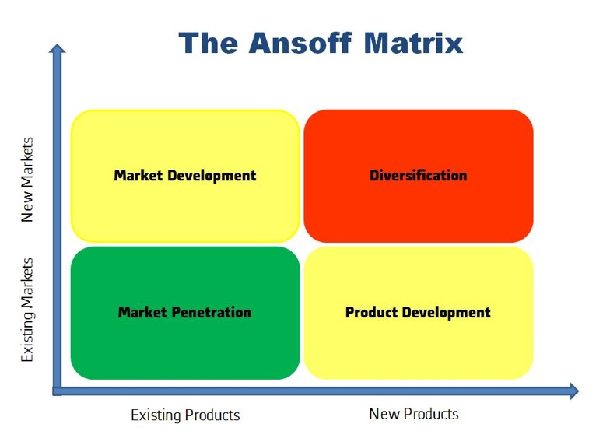
4 common ways to grow a company or product line
Image source: https://en.wikipedia.org/wiki/Ansoff_matrix

Slide 28
Ansoff Matrix explanations
Reference
Market penetration strategy
Grow by selling more of your products into its existing targeted markets. Increases market share.
- How: Product refinement, more marketing and sales/distribution, pricing decrease. Acquisition of competitors.
- lower risks, lower rewards
Market development strategy
Grow by expanding into markets that are new to your company (geographies, industries, etc.)
- How: minimal product development, new sales and marketing programs, business partnerships
- moderate risks, moderate rewards
Product development strategy
Grow by creating new products and services for your existing target markets.
- How: invest in R&D of new products, major improvements. Acquiring companies with the desired products.
- moderate risks, moderate rewards
Diversification strategy
Grow by creating new products for markets that are new to your company.
- how: invest in R&D of new products, invest in new sales/distribution and marketing. Acquire companies with the desired products and markets.
- high risks, high rewards

Slide 29
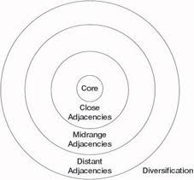
One Path to Take: Book: “Beyond the Core” by Chris Zook, Bain & Company consultant
Start with the Core
Your strongest position – product and market.
Move into a Close Adjacency
Tied to your strongest position, but a short “distance away” – expand from what you already know well - a market or a product/tech.
…do it again in another adjacent area
Eventually move into a Distant Adjacency
Achieve diversification

Slide 30
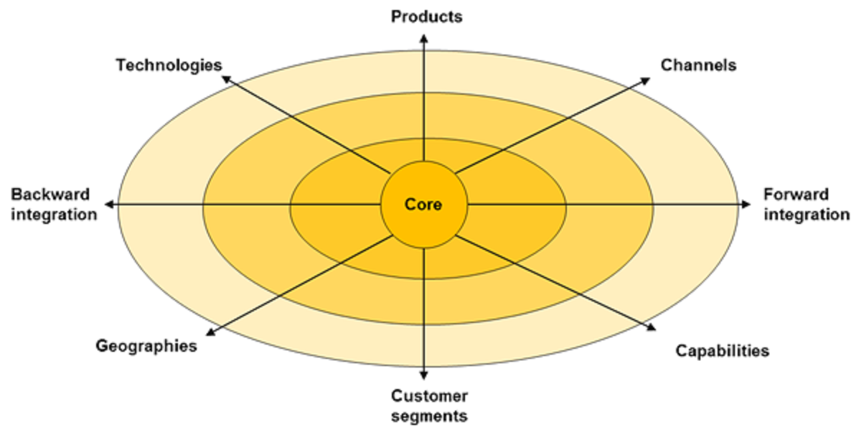
There are many possible ”Adjacency” possibilities.
Image source: https://globaladvisors.biz/2017/11/09/profit-from-the-core/
Notes:
https://globaladvisors.biz/2017/11/09/profit-from-the-core/

Slide 31
Common Product Line Strategies for growth.
Horizontal – grow by offering the same product to more markets
Example: Saleforce.com for Automotive, Manufacturing, Education, etc.
Vertical – grow by offering more new products to the same target market / customers
Example: Salesforce.com → Sales Force Automation, Territory Planning, Revenue Optimization
Segmented – grow by offering products that are unique for each target market.
Example: personal checking account; small business checking account.
Augmented – grow by offering additional complementary products to the core product.
Example: laptop computer → mouse, keypad, carrying case, adapters
Platform – grow by offering different products to each ”side” of a marketplace.
Example:
To “searchers” side - Google Keyword Search. Google Image Search. Google Book Search.
To ”advertisers” side – Google Search Ads. YouTube Video Ads. Shopping Ads. App Ads.

Slide 32
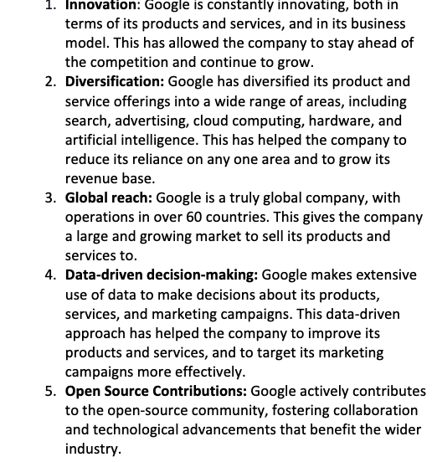
Example “How” for Google.

Slide 33
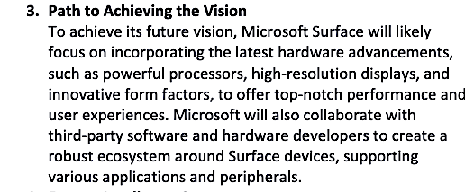
Example “How” for Microsoft Surface

Slide 34
Workshop
Find its business strategy for your chosen company.
Look for answers to:
Objective – the goals and vision
Scope – which markets, users will they serve?
Advantage – why will they win? What makes they unique?
How – how will it get there

Slide 35
Discussion
Share:
1 – the company name
2 – the name of the product line
3 – what sources did you use?
4 - what did you find? or couldn’t find.
Objective (goal or vision)
How it will get there
Where it will play
Why it will win (advantages)

Slide 36
The End

